Slide 1
Scalable Global Solutions JSC
Channel partners
Social media campaigns

Slide 2
Test campaigns Linkedin:
Plan cost:
Invest | Impressions | Clicks | Cost per click
1000€ | 200,000 | 600 | 1,5€
www.sgs-daas.com

Slide 3
Target concept:
Reach existing channel related executives
Offer them DaaS for their customers
Offer them Channel partnership
Campaign goal:
Inform Channel partners about SGS Channel partnership existance
Attract Channel partners to join our Channel partnership program
Contact – give to potential interested partners first Promo PDF brochure
Needed steps:
Select target audience by job position
Select companyes by size
Select geographically target audience
Select business niche
Scalable Global Solutions JSC
Uica grada Vukovara 284Zagreb, HR-10000, Croatia +385 1 353 5930
www.sgs-daas.com

Slide 4
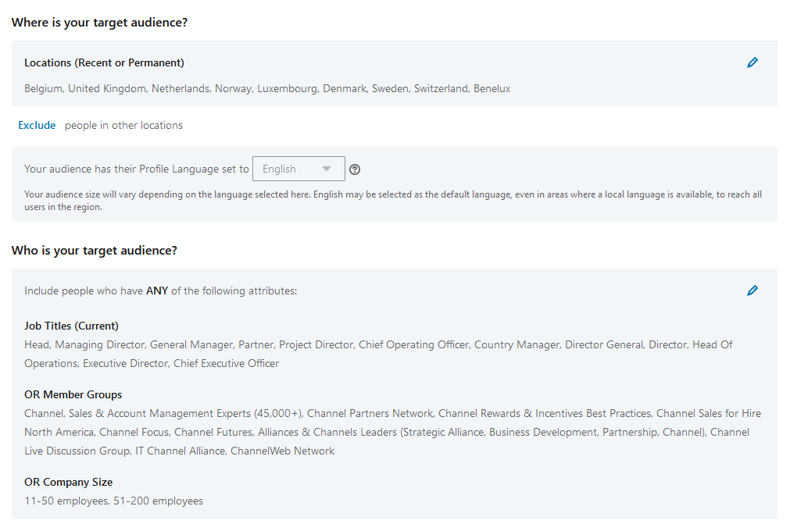
Campaign targeting:
Scalable Global Solutions JSC
Uica grada Vukovara 284Zagreb, HR-10000, Croatia +385 1 353 5930
www.sgs-daas.com

Slide 5
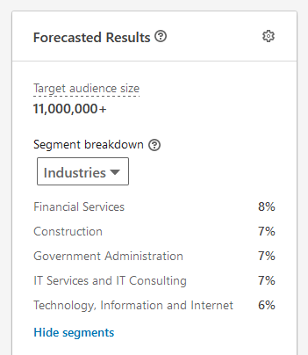
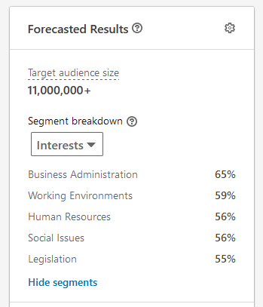
Campaign targeting:
Scalable Global Solutions JSC
Uica grada Vukovara 284Zagreb, HR-10000, Croatia +385 1 353 5930
www.sgs-daas.com

Slide 6
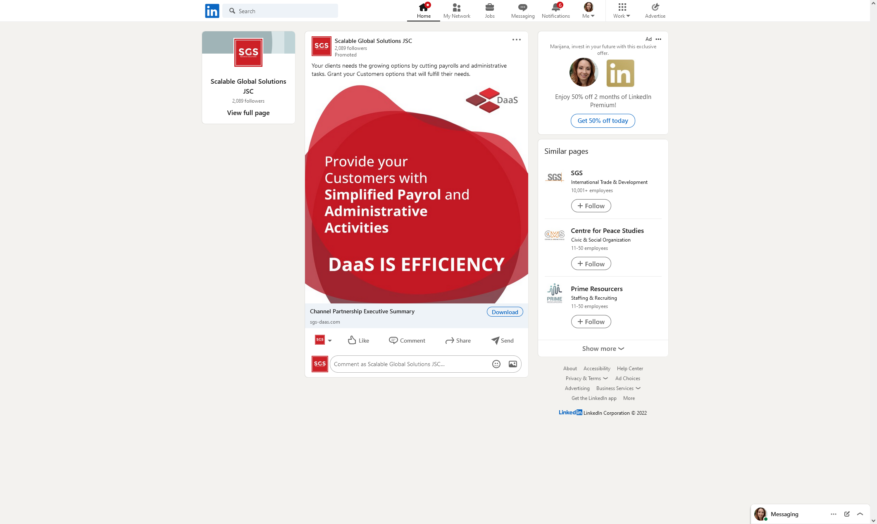
Scalable Global Solutions JSC
Uica grada Vukovara 284Zagreb, HR-10000, Croatia +385 1 353 5930
www.sgs-daas.com

Slide 7
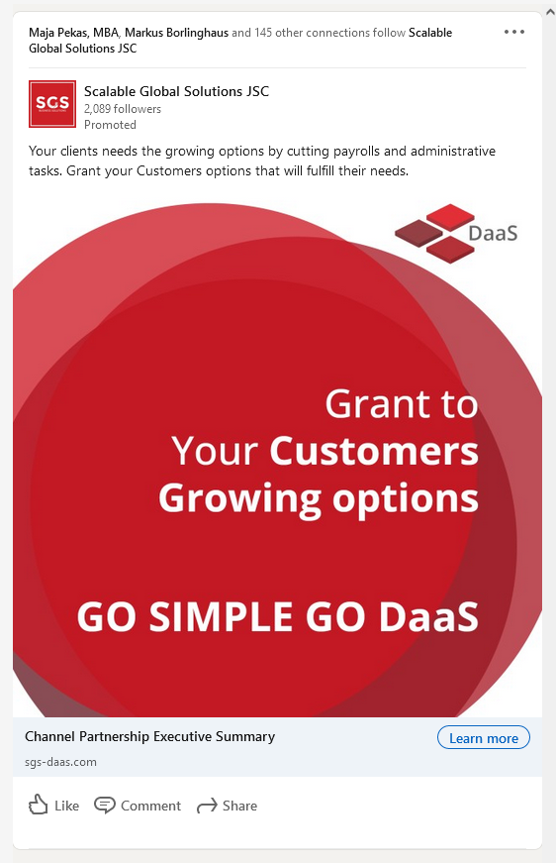
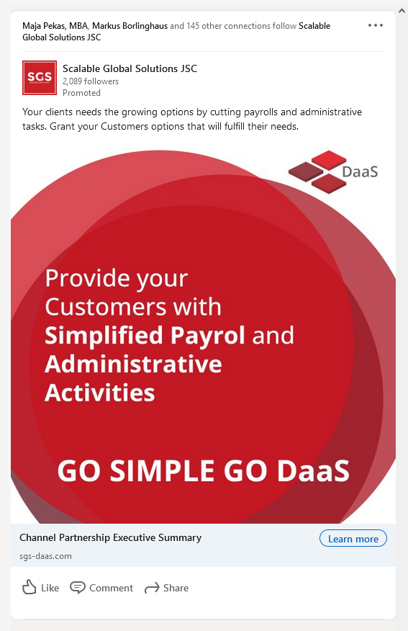
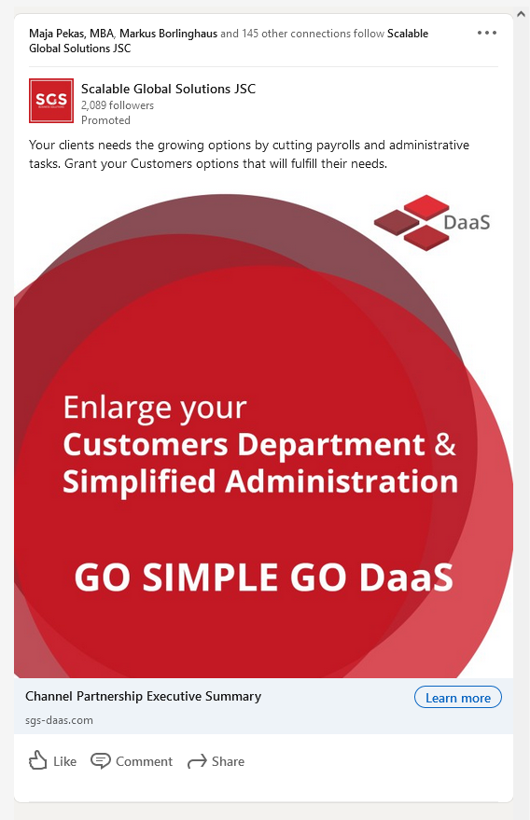
Scalable Global Solutions JSC
Uica grada Vukovara 284Zagreb, HR-10000, Croatia +385 1 353 5930
www.sgs-daas.com

Slide 8
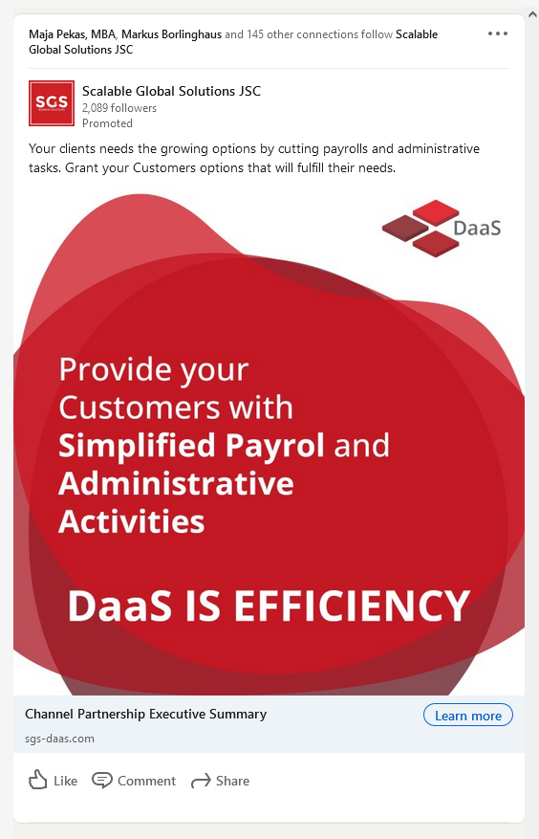
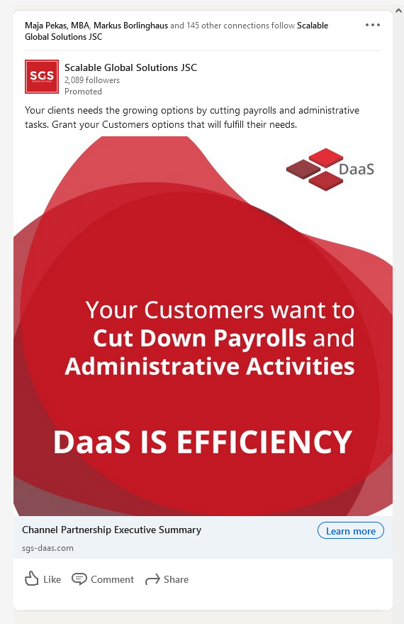
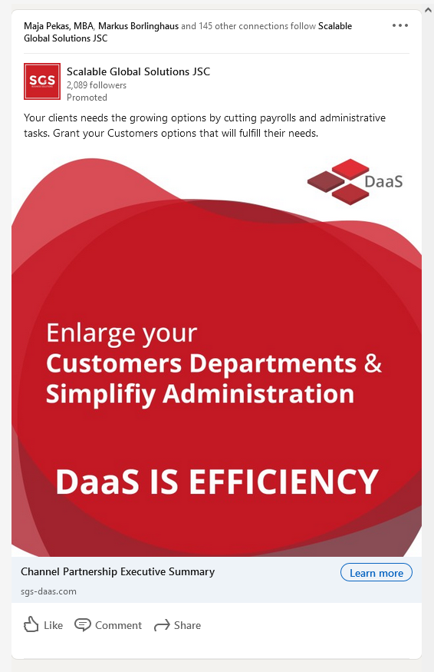
Scalable Global Solutions JSC
Uica grada Vukovara 284Zagreb, HR-10000, Croatia +385 1 353 5930
www.sgs-daas.com

